Slide 1
Thesis Proposal
Yasaman Razeghi

Slide 2
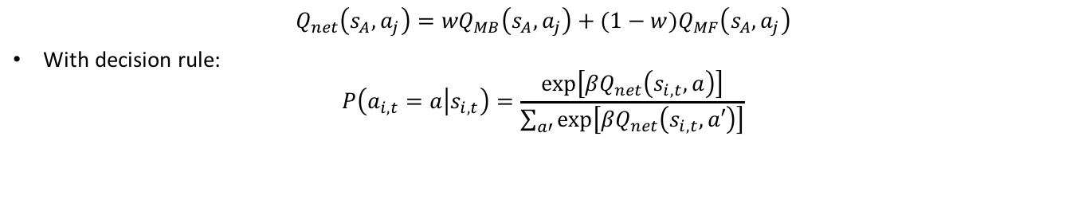
The Daw’s Model
Humans behavior displays hallmarks of both strategies with a W parameter.
$$Q_{net}\left(s_{A},a_{j}\right)={wQ}_{MB}\left(s_{A},a_{j}\right)+{(1−w)Q}_{MF}\left(s_{A},a_{j}\right)$$
With decision rule:
$$P\left(a_{i,t}=a | s_{i,t}\right)=\frac{exp⁡\left[{βQ}_{net}\left(s_{i,t},a\right)\right]}{\sum_{a′}{\exp\left[{βQ}_{net}\left(s_{i,t},a′\right)\right]}}$$

Slide 3
Trying to manipulate the W
Learning to find the optimal strategy by something like gamification.
Biasing addicted people to model based behavior.
First we should find the situation dependency of the w.
Finding the influence of different factors on w.

Slide 4
My Hypotheses
This parameter may not be constant over the Task.
There may be some higher system controlling over this parameter.
How does this higher system work?
What are the factor.

Slide 5
Factors
Emotions
Fear
Sadness
Joy
Timing
Task probability
Task reward function
Attention
Intensity of brain regions activity
E.g. In drug usage
Dopamine
The way of information transferring to subject
...

Slide 6
More Reliable Factors
Timing
Task reward function
Information transferring
I think I should read and think more in this part.

Slide 7

To learn or not to learn?

Slide 8
Lee et al. (2014)

Slide 9
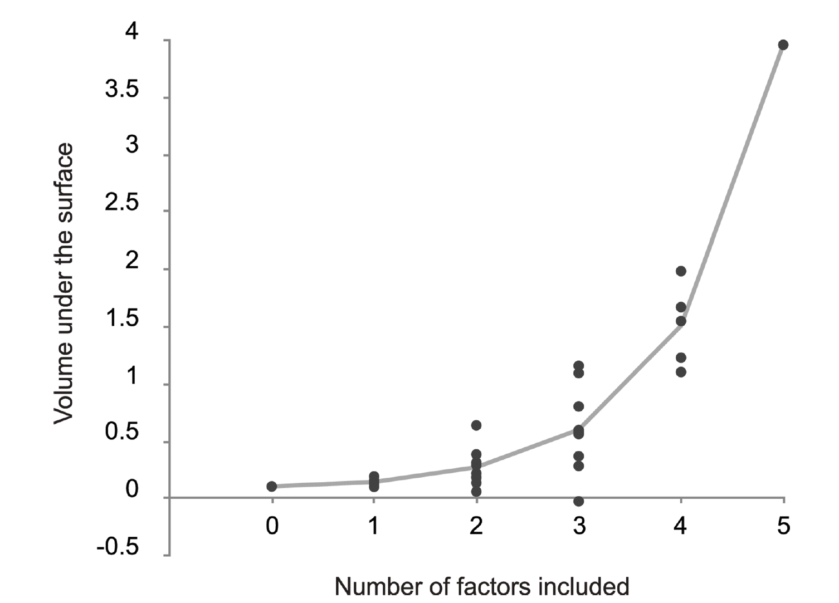
Trying to bias toward MB or MF by Task

Slide 10
Main question
Trying to find the factors

Slide 11
The performance problem.
Thinking about the reasons.
Controlling the factors.

